Slide 1
Introduction to data structures
A.H. Amalorpava Akila
Assistant Professor,
Department of Computer Science,
St.Joseph’s College(Autonomous),
Tiruchirappalli – 620 002.

Slide 2
What is Data structure?
Data structure is a way of collecting and organizing the data in such a way that we can perform operations on these data in an effective way. The operations are adding, updating, deleting, sorting, searching the data and so on.
For example, we have some data which has, Employee's name “Raju" and age 25. Here “Raju" is of String data type and 25 is of integer data type.
We can organize these data as a record like Employee record, which will have both employee's name and age in it. Now we can collect and store employee's records in a file or database as a data structure.
For example: Employee Name Age
“Tony” 25,
“Arun” 33,
“Gokul” 26

Slide 3
Types of Data structures
  Primitive data structures
      Built-in data structures
  Non-primitive data structures
      User defined data structures

Slide 4
Types of Data structures
Primitive data structures
      char ( Example: char sex=‘m’;
      char ename[25]; )
      integer ( Example: int age; )
      float (Example: float salary; )
      Boolean (Example: bool flag; )
      Pointer ( Example: int *p, q=10; )
      p=&q;

Slide 5
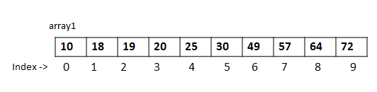
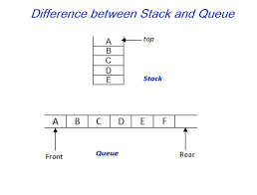
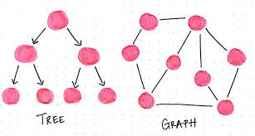
Types of Data structures
Non-primitive data structures
      Arrays
            Array is a kind of data structure that can store a
            fixed-size sequential collection of elements of the
            same type.
            ( Example: int num[10];,
            char choice[3]=“yes” )
      Lists
          Linear list ( stacks and queues using an array)
              Data items are arranged in sequence.
              Traverse through elements or nodes sequentially.
              ( Example: Array )
          Non-linear list ( Trees and Graphs )
              Data items are not in sequence.
              One node might be connected to several other nodes
              it can’t always be traversed sequentially.
              ( Example: Trees and Graphs )
      Files
              A file is an object on a computer that stores data and information. A file is created using a software program on the computer. For example, to create a text file you would use a text editor.
              Computer files are stored on a drive (e.g., the hard drive), disc, (e.g., DVD).

Slide 6
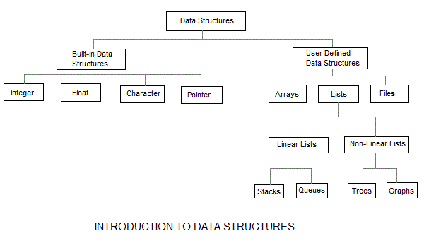
DATA STRUCTURES

Slide 7
Thank You

